Slide 1
Two-Mode (Bipartite) Networks
aka Affiliation Networks

Slide 2
Network Data
What if you do NOT have social network data?
  i.e. information on interactions among persons
What if you have attendance data?
  who is a member of which club?
  who went to which social event?
  who is a member of which board of directors?
Can you generate a good representation of the social network?

Slide 3
Affiliation Data
Actors and movies
Scientists and papers
Persons and “organizations” (or events)
Persons and boards of directors that they are on
Broadway plays and the people that create/produce/act in them
Persons and objects (e.g., books purchased on Amazon, movies from Netflix)
Photos and tags
Countries and products

Slide 4
Two mode networks
A two-mode (affiliation, bipartite, dual, membership, hyper) network consists of:
  Two types of vertices.
  Edges that join between types but not within types.
Affiliation networks are composed of three elements:
  A set of actors (g)
  A collection of subsets of those actors (h)
  A relation (membership) linking each actor to each event

Slide 5
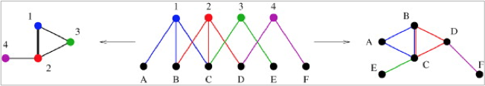
A two-mode network and one-mode projection
Letters are people; numbers are clubs in which they are a member
Can read both up and down: A is in Club 1; Club 1 has as members A, B and C
Degree = size of the club; number of clubs in which a person is a member
One-mode projection
  For clubs: put an edge if they share at least 1 member
  For persons: put an edge if they are in at least 1 club together
  Weighted edges: # of members shared; # of clubs both people are in
  Degree: # of people that a person is in the same club with ( # of 2-paths); # of clubs that a club shares people with

Slide 6
Two mode networks
The first detailed treatment of affiliation networks is due to Breiger (1974) in a now classic paper on "The duality of persons and groups"
  Affiliation networks can be used to formalize a classic notion
  The relations between entities are co-constituted by their relations to another set of entities (Simmel 1971)
Duality
  Persons are related by the set of group memberships they have in common
  Events are related by the set of persons who participate in both

Slide 7
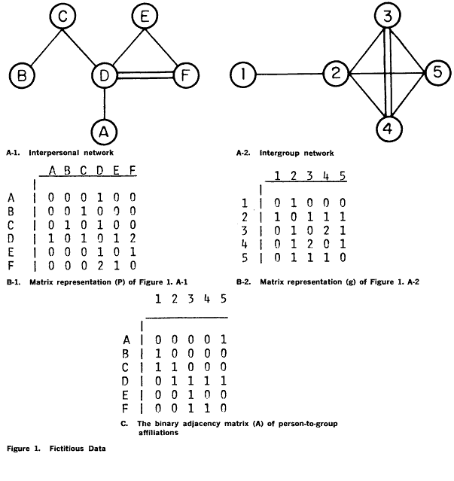


One mode projections
Affiliation networks can be represented with an affiliation matrix A of dimensions g x h, where
  g is the number of actors (rows)
  h is the number of events (columns)
  A_{ik} = 1 if actor i is affiliated with event k and zero otherwise

Slide 8
One mode projections
The affiliation matrix yields a co-membership matrix X^{M} and an event overlap matrix X^{N}, where:
  The ij^{th} cell of X^{M} records the number of common persons shared by events i and j
  The ij^{th} cell of X^{N} records the number of common events shared by actors and i and j

Slide 9
One mode projections
Note that A uniquely determines both X^{M} and X^{N}
However, the reverse is not true (Faust 1997)
  A given co-membership matrix or event-overlap matrix may be consistent with very different affiliation matrices

Slide 10
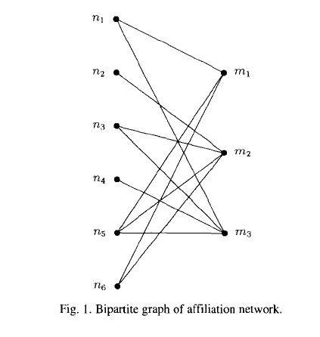
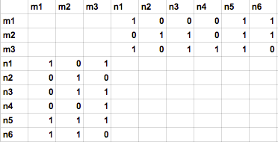
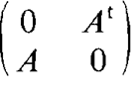
The bipartite graph
An affiliation network may also be represented as a bipartite graph X^{NM} of dimensions (g + h)
Because links exist only across the two types of vertices, the bipartite graph of an affiliation network has two "zero blocks"

Slide 11
Centrality in affiliation networks
Centrality measures in affiliation networks can be motivated in four different ways:
  The centrality of actors (number of events that they participate in)
  The centrality of events (number of actors that participate in the event)
  The relationship between the two (do central actors tend to participate in central events?)
  The dual constitution of the two (the centrality of an event is proportional to the centrality of the actors that participate in it and vice versa)

Slide 12

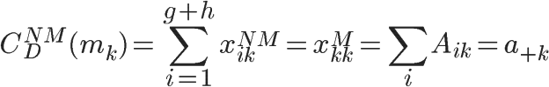
Centrality in affiliation networks
Using the bipartite graph (X^{NM}), we can define the degree centrality of an actor (the number of events that they participate in) as:
And the same for the degree centrality of an event (size of the event):

Slide 13

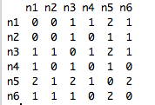
Centrality in affiliation networks
We may also define actor-level centrality from the co-membership matrix
  (one mode projection)
The row sum of the number of non-zero entries (a binarized version)
  Gives us the number of distinct actors k^{N} with which an actor shares and event in common
    Note: Based on 2-paths

Slide 14
Centrality in affiliation networks
The row sum of the raw entries gives us the number of contacts
  (double-counting actors each time they are encountered)
That an actor comes into contact with by virtue of participating in an event
  This is equal to the sum of the sizes - 1 of the events in which the actor participates

Slide 15

Centrality in affiliation networks
Events may also be thought of as having a "degree centrality"
  The row sum of the entries of the event-overlap matrix gives us the sum of the number of memberships of all of the actors that participate in the event
  There is a relationship between actor and event centrality
    The centrality of an actor is equal to the sum of the sizes of the events that she participate in
    The centrality of an event is equal to the sum of the number of memberships of the actors that participate in it

Slide 16
Why One Mode Projection: The Role of Social Foci
share a focus → engage in joint activities → form a tie
foci vary in how constraining they are
  more constraining → more likely to interact → form a tie
  larger the focus → less likely to interact → less likely to form a tie
  more foci two people are in (especially if compatible) → form a tie
  triadic closure: share a focus with a common friend
  bridging: foci inhibit bridging
    bridgers more likely to be in two less compatible foci
  clustering coefficient: higher when individual draws ties from the same foci
    ..a social, psychological, legal, or physical entity around which joint activities are organized (e.g., workplaces, voluntary organizations, hangouts, families, etc.). -- Feld, Scott L. "The focused organization of social ties." American journal of sociology (1981), p 1016

Slide 17
Tie Formation
When is a social tie more likely to occur between two persons?
  Homophily: when two persons are similar on some trait
  Triadic closure: when two persons have a friend in common
  Proximity: when two persons are affiliated with the same organization (place, event…)
One-mode (interpersonal) network is a measure of vertex similarity
Similarity → tie formation. Why?
  attracted
  likely to meet, bump into each other
    through a common friend
    through a common affiliation

Slide 18


Eigenvector centrality in affiliation networks
The eigenvector centralities of actors and events may be defined in the same way
  Actors gain centrality from participating in central events
  Events gain centrality when highly central persons participate in them

Slide 19


Eigenvector centrality in affiliation networks
The eigenvector centralities of actors and events may be defined in the same way
  Eigenvector centralities of two mode networks explicitly incorporates the duality between actor and event centralities:

Slide 20
Closeness
Distances between
  Actor and other actors
  Actor to all events
For an actor closeness centrality is a function of minimal distances from
  any of its events to other actors
  any of its events to other events
For an event, closeness centrality is a function of minimal distances from
  its actors to other actors
  its actors to other events
Notes:
Look at Sum d(i,k) n2 vs. n5
*

Slide 21
Betweenness
Actors always on geodesics between events
  Events always on geodesics between actors
An event gains betweenness centrality when pairs of its members only meet through that event
  (i.e. its actors belong to no other events)
An actor gains betweenness centrality when it is the only actor that is affiliated with a pair of events
  (i.e. the actor is the only member of the event)
Notes:
For an event: irony, if most members not in any other events, higher betweeness centrality, i.e. non-central actors create high event betweeness centrality
For an actor, if it belongs to an event with only one member (it), the actor gains betw centrality
LIKE actors bridge events and have more centrality to the extent that only they do so
events bridge actors and more more centrality to the extent that only the event does so
Events: Look at n2 to n6, must go through M2, which gives M2 higher centrality
Actors: Look at N5 vs. N4 (or N2).
N5 connects all three events, while N4 and N2 connect none (because they only belong to one event).
*

Slide 22
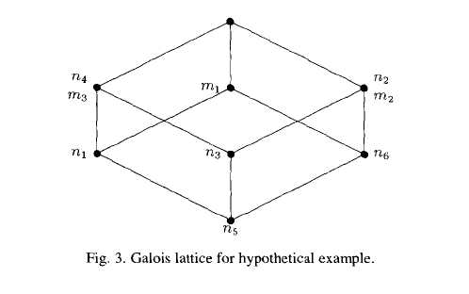
Overlap
Events are a sets of actors
Actors are sets of events
Ascending lines connect actors to subset of events it is affiliated with
Descending lines connect connect each event to actors that it is affiliated with
Lines connecting actors (events) indicate subset relations
Lower actors in diagram are more central
Higher events in diagram are more central
Notes:
Subsets. For example n5 set (m1, m2, m3) covers n3 (m2, m3) , which covers n4 (m3) and n2 (m2)
In this case no overlaps among events
*

Slide 23
Analyzing large scale two mode networks
Some terminology:
  A bipartite graph G= (V^{T}, V^{B}, E) is triplet consisting of
    "Top" nodes (V^{T})
    "Bottom" nodes (V^{B})
    And a set of edges (E)
    Nodes are in two disjoints sets such that links go from nodes in one set to nodes in the other
  Basic statistics
    Graph size: n = |V|
    Number of edges: m = |E|
    Average degree: 2m / n
    Density: 2m / (n(n-1))

Slide 24
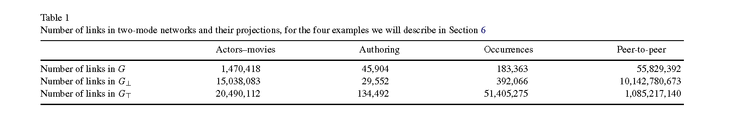
Extension of basic statistics to two mode networks
Standard approaches to analyzing two-mode networks involve deriving the one-mode projection, this approach is not always ideal:
  Information loss: bipartite structure is lost after projection
  Artifactual properties: Clustering/density in the one-mode projection may not reflect the actual magnitude/presence of those properties in the two-mode network
  Edge inflation: m in the one-mode graph is much larger than in the bipartite graph (each actor/event contributes multi-edges)

Slide 25
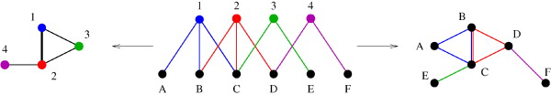
Extension of basic statistics to two mode networks
To deal with this issue Latapy and colleagues (2008) have proposed a "projection-free" approach for the analysis of (large) two-mode networks
This involves extending and finding analogues for:
  Basic statistics in the two-mode case
  Distributional analysis of degrees to the two mode case
  Notions of clustering for the two mode case

Slide 26
Extension of basic statistics to two mode networks
Number of (top) Nodes: n↑
Number of (bottom) Nodes: n↓
Number of edges: m.
Average (top) degree: k↑ = m/n↑
Average (bottom) degree: k↓ = m/n↓
Average Degree in the Bipartite graph:
  k = 2m / (n↑ + n↓)
Density in the two-mode graph:
  δ(G) = m / (n↑n↓)
Density in the Bipartite Graph:
  δ(G’) = 2m / (n↑ + n↓)(n↑ + n↓ - 1)

Slide 27
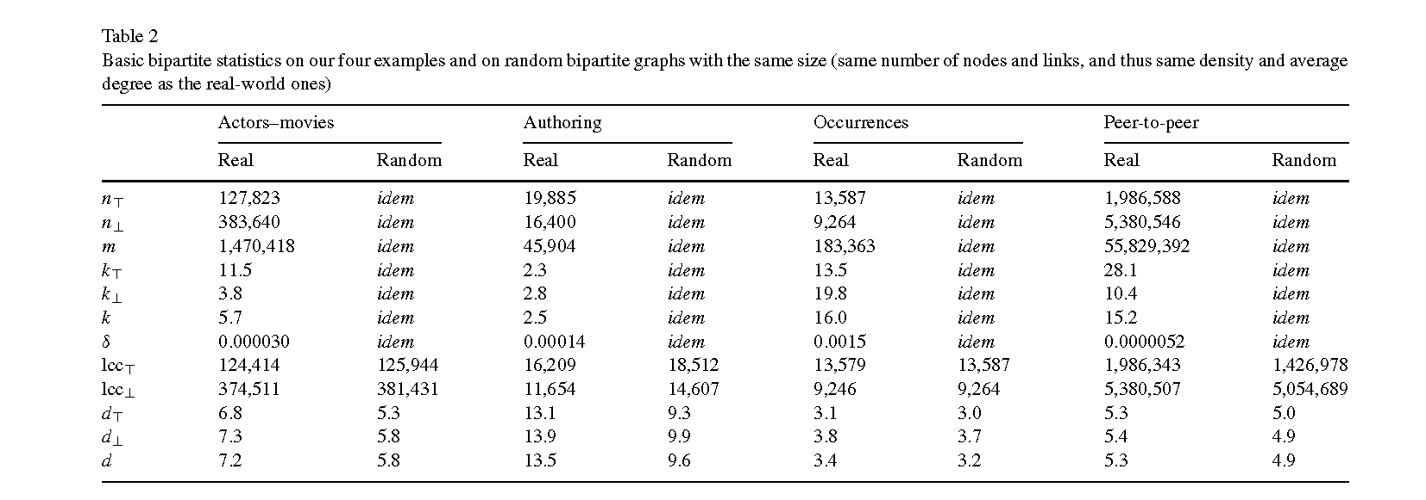
Extension of basic statistics to two mode networks

Slide 28
Extension of degree-distribution analysis
p_{k}↑ Fraction of top nodes with degree k
p_{k}↓ Fraction of bottom nodes with degree k
  We may be interested in whether the distribution of degrees is homogeneous (normal) or heterogeneous (long-tailed)
  We can do this by comparing the observed distribution with the expected distribution of a random two-mode graph of the same size
r↑↓ is the correlation between top and bottom degree

Slide 29
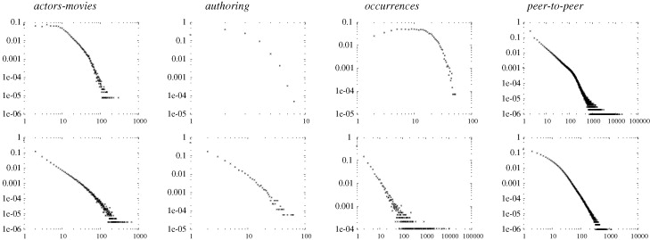
Degree distribution in two mode networks

Slide 30
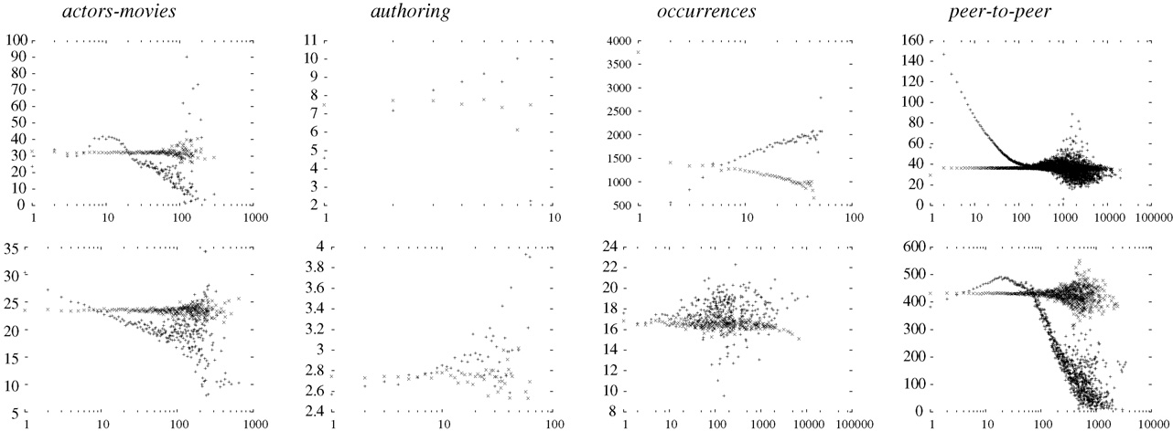
Degree correlations in two mode networks

Slide 31
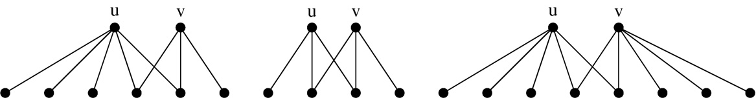
Extension of neighborhood notions
For a (top or bottom) node v, the immediate neighborhood N(v) is the number of nodes of a different type directly linked to it
We may extend that notion to the Distance-2 neighbors N(N(v))
  In the bipartite graph, these are the number of (top/bottom) nodes that a node of the same type can reach via a node of a different type
  Gets at the same information as centrality in the one-mode co-membership matrix without losing the bipartite structure

Slide 32
Extension of neighborhood notions
A key indicator of the "efficiency" with which a given node connects to others is given by the correlation between a node's degree and the number of distance-2 neighbors compared to the same correlation in the corresponding random two-mode graph
  This information is usually lost in the one-mode projection

Slide 33
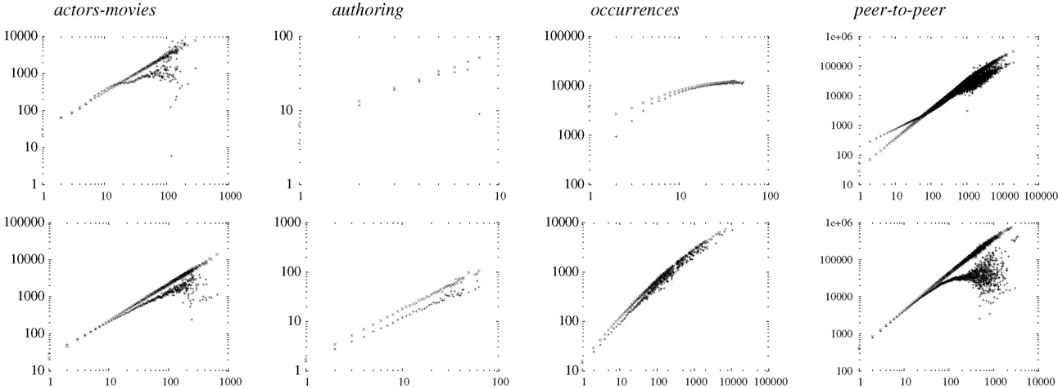
Corr. between top and bottom degree and N(N(v))

Slide 34


Extension of clustering notions
The clustering coefficient between any two nodes cc.(u, v) which belong to the same set (top or bottom) is given by the intersection of their one-step neighborhood divided by their union:
This definition only applies to pair of nodes, but we want a measure of clustering at the node level
We can do this by taking the average of clustering between u's distance-2 neighbors:

Slide 35


Extension of clustering notions
We can follow a similar approach to define the average clustering for all top nodes:
And the average clustering for all bottom nodes:
Total graph clustering:
  cc(G) = (n↑cc.(↑) + n↓cc.(↓)) / (n↑n↓)

Slide 36

Extensions of clustering notions
The previous definition of clustering uses the average across top and bottom nodes
  We may also define a graph clustering measure that is the analogue to the "counting triangles" measures of one-mode (triadic) clustering
    In the two-mode case, we count "Quadruplets" (four node sets with two nodes of each kind and least three edges) instead
Realized
Possible
?

Slide 37


Extension of clustering notions
When there is heterogeneity in the (top or bottom) degree, the standard intersection over union strategy to measure dyadic clustering may not be effective
  It is likely that one node's neighborhood will be completely swamped by the other
In this case, a "min" or "max" clustering strategy may be most appropriate:

Slide 38


Extension of clustering notions

Slide 39
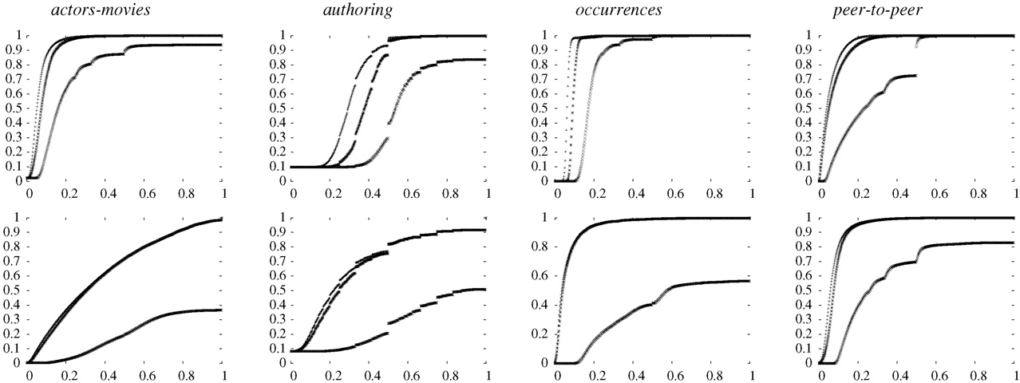
Cumulative distribution of clustering coefficients

Slide 40
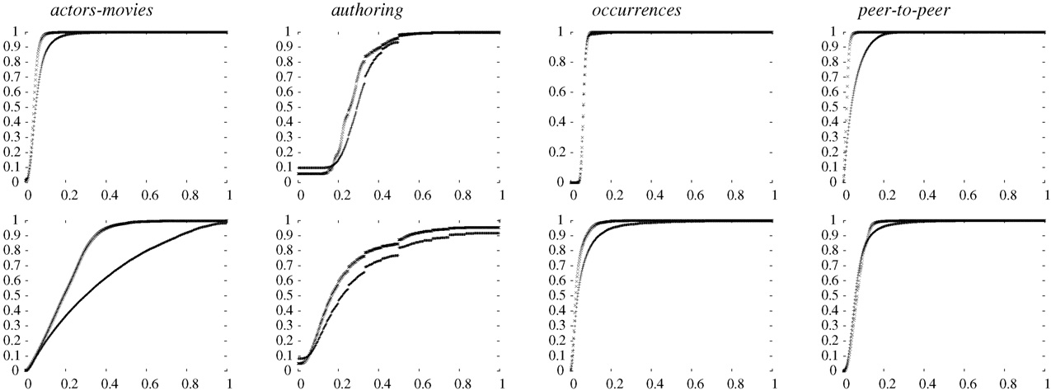
Cumulative distribution of cc. (real vs random)

Slide 41
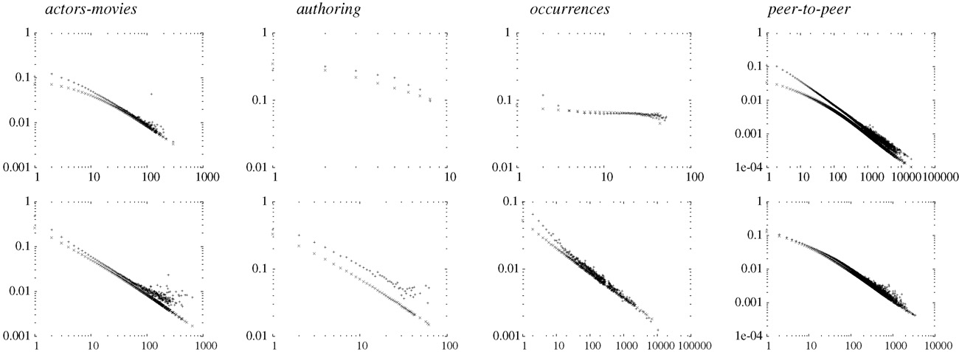
Correlation between node degree and clustering

Slide 42
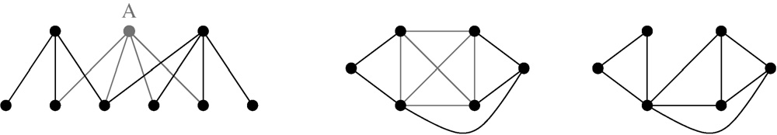
Redundancy in two-mode networks
B
A
C
1 2 3 4
4 / 6 = 0.66

Slide 43
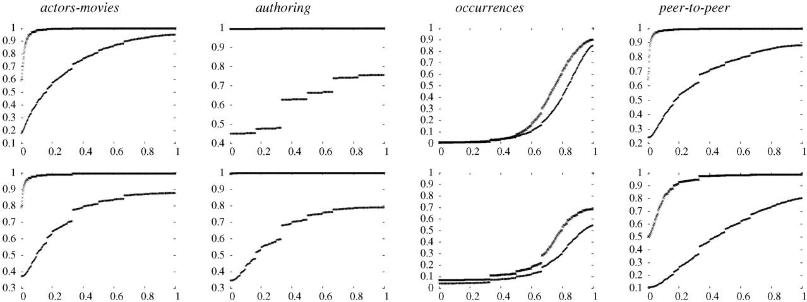
Cum. Distribution of redundancy (real vs random)

Slide 44
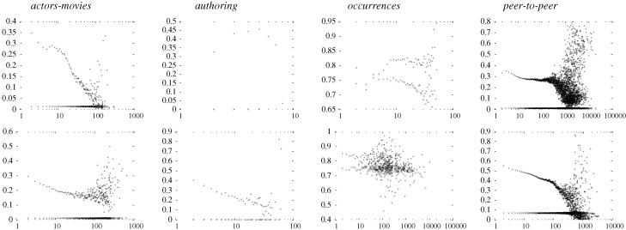
Correlation between redundancy and node-degree

Slide 45
Advanced centrality notions in two mode networks
As Faust noted a distinctive feature of centrality scores in two-mode networks is that the scores in one-mode depend on the scores in the other mode
Hidalgo and Hausman (2009) show that this principle can be generalized to compute a set of recursive quantities that they refer to as the method of reflections
  Different "levels" of reflection modify the substantive interpretation of a given centrality score across the two modes

Slide 46




Advanced centrality notions in two mode networks
Consider the standard two-mode data matrix (A_{ik}) with modes g and h.
Reflective centralities are given by the quantities:
with:

Slide 47
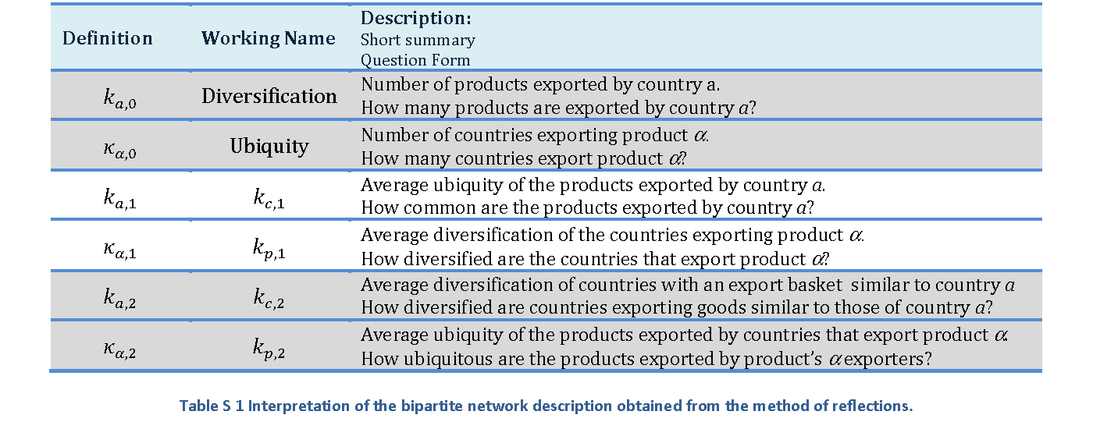
Advanced centrality notions in two mode networks

Slide 48
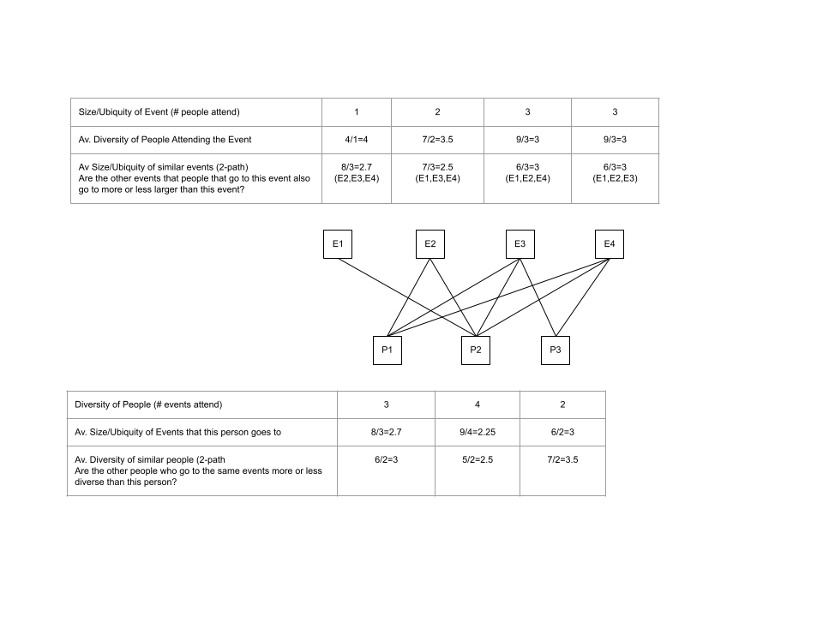
Method of Reflection

Slide 49
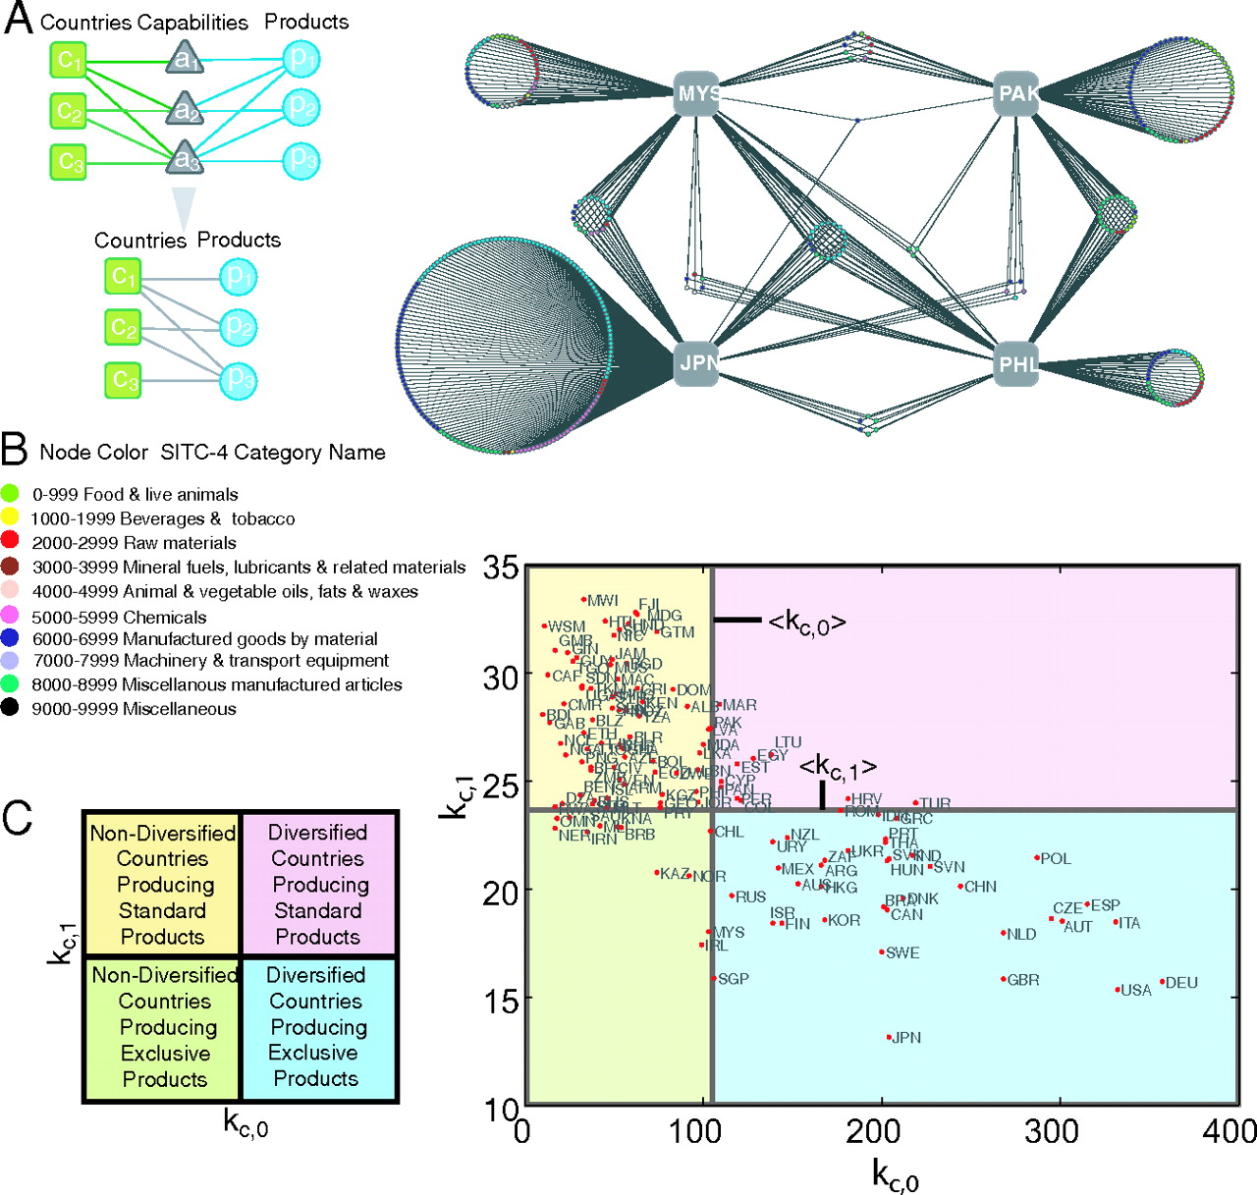

Slide 50
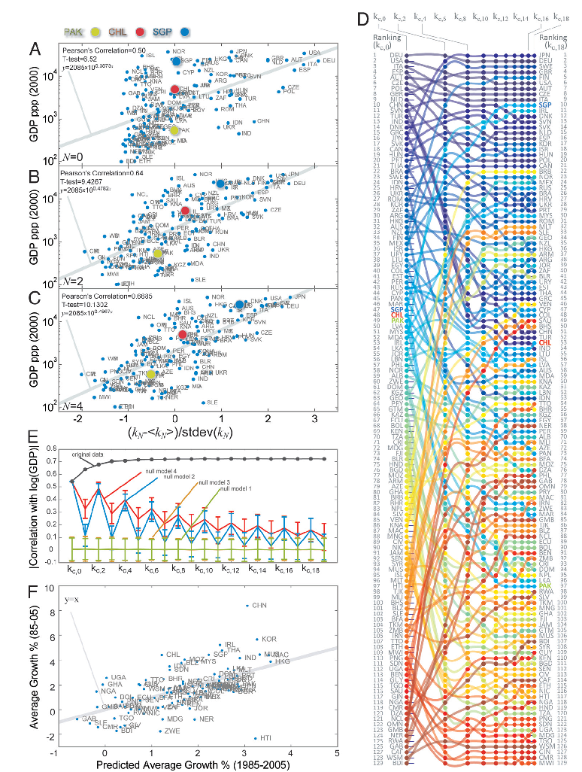

Slide 51
